Slide 1
Campaign – webinar

Slide 2
Webinar - efficient tool for lead generating

Slide 3
Why using webinars
It is time-saving. You can have a large number of attendees without thinking about geography and the cost of holding meetings.
The participants do not have any wasted time. They can attend the meeting no matter where they are. They just need to have access to a computer with internet.
It is non-binding to participate and provides the opportunity to get new inspiration in an easy way.
You can record the webinar and fx send it to those who are prevented from attending or use the recorded version in your sales work.

Slide 4
How to get succes with webinars - 1
You need to define a target group and a subject for the webinar.
Examples of headlines:
How to avoid consequential damage in case of a fire.
How to avoid downtime and damage in case of fire.
Secure your business continuity with Inergen as fire protection.
Inergen – when safety and sustainability are the essence.
Choose a webinar solution. We use Microsoft Teams.

Slide 5
How to get succes with webinars - 2
Create an invitation that you can send to the target group
Send out the invitation – use fx mail address, SoMe, newsletter or other channels to contact the target group
It is a good idea to hold the same webinar on different dates and time slots, so that the participants have something to choose among.
Make a presentation that looks professional and have the right content for the target group.
Create a landing page or use another way for easy sign-up for the webinar.
After sign-up send a confirmation to the participants with a link to the webinar.

Slide 6
How to get succes with webinars - 3
Send out a reminder several times before the event. Fx 1 week before, the day before and an hour before the webinar begins.
After the webinar you can send out an evaluation where you fx ask if the person wants a personal meeting. Or you can do the following up by telephone.
Next step could be to invite the participants for a live demonstration on how Inergen works in your office depending on your facilities.
We are happy to help you all the way with webinars

Slide 7
Example of an invitation…

Slide 8
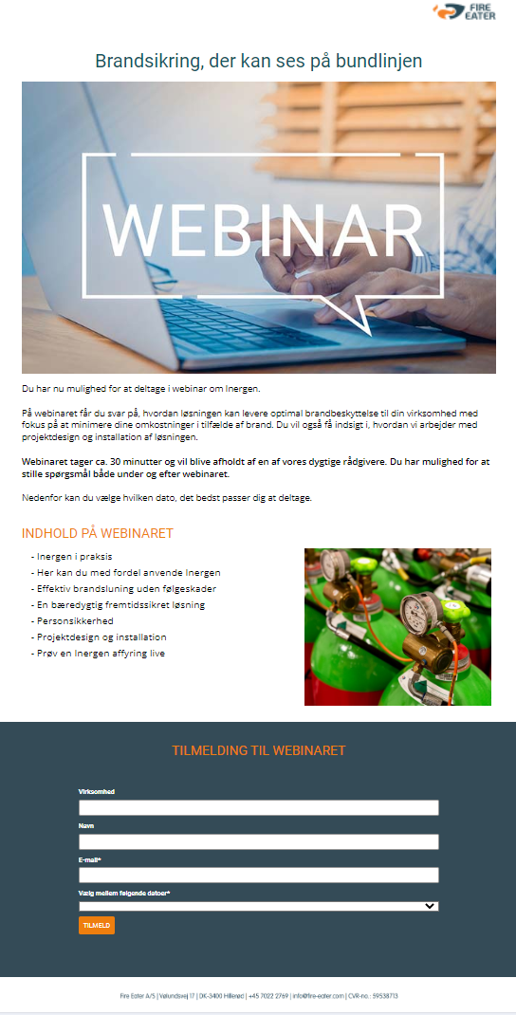
Example of a landing page

Slide 9
Contact your Key Account Manager if you want our help to hold webinars

