Slide 1
FIRE EATER A/S
Inergen fire extinguishing systems

Slide 2
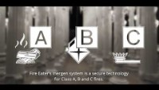

Slide 3


Subsidiaries
Denmark
Norway
UK & Ireland
USA
Saudi Arabic - Coming soon

Slide 4
Fire Eater´s philosophy Fire Eater focuses on creating cutting-edge innovative fire protection products for business applications. Our goal is to provide fire protection solutions that protect human life, property and the environment.

Slide 5
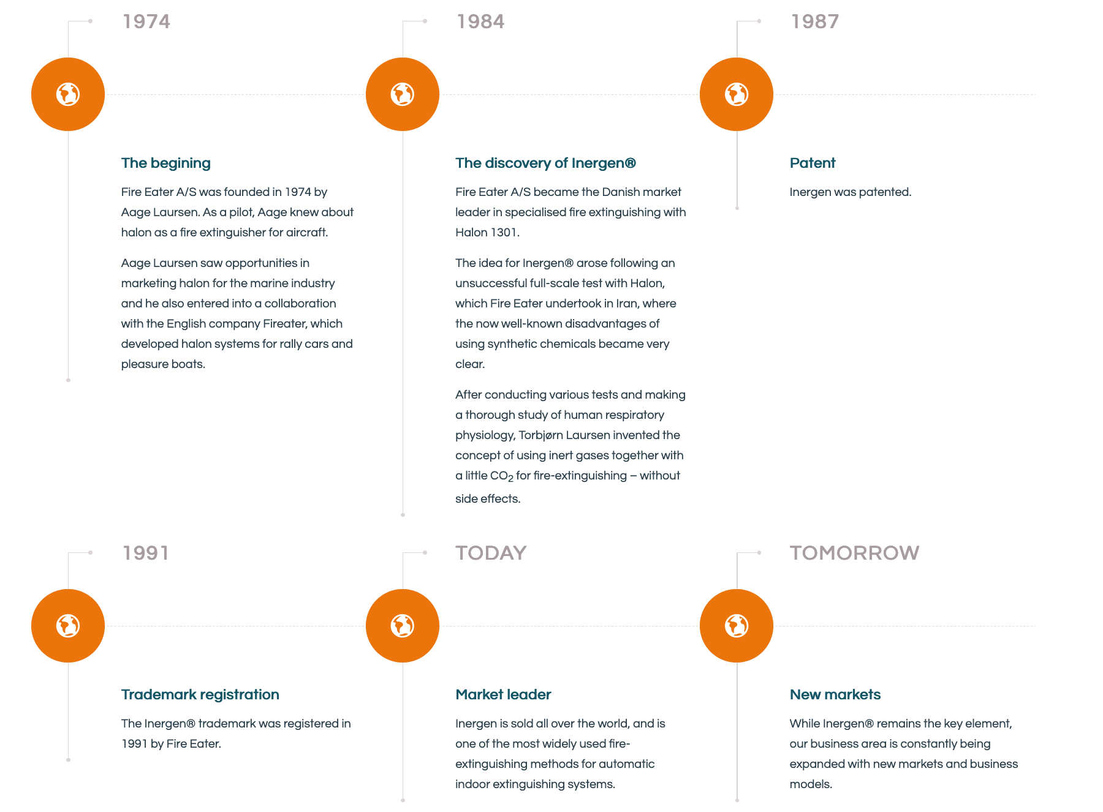
Milestones in the history of Fire Eater

Slide 6


Approvals
Bureau Veritas – Marine & Offshore
CNBOP-PIB- Center for Scientific Research Protection, PL
FM Global - Factory Mutual Insurance Company, US
Intertek ISO 9001:2015
Intertek ISO 14001:2015
UL- Underwriters Laboratories Inc., US
ZÚS - Technical & Test Institute for Construction Prague, CZ
DBI- Dansk Brand- og Sikringsteknisk Institut, DK
MARITIME NEW ZEALAND
ABS - American Bureau of Shipping
LPCB - Loss Prevention Certification Board, UK
CCC – Chinese
DNV-GL – QS certificate of assessment – EC (module D)
DNV-GL – EC type examination certificate (module B)
PESO - Indian
VdS - German

Slide 7
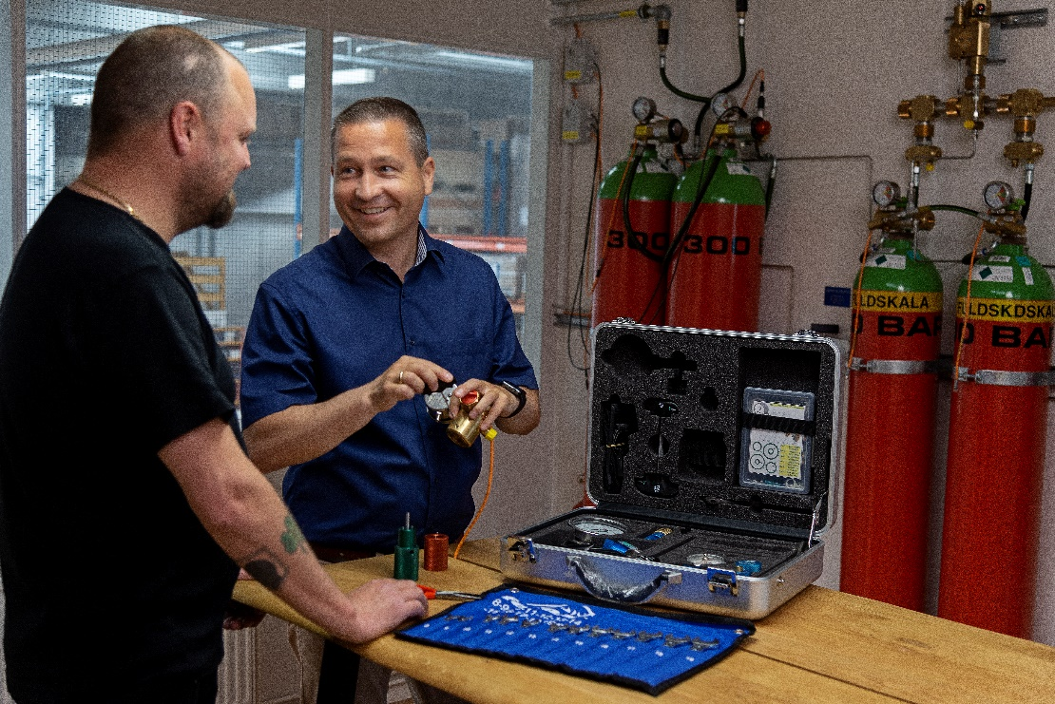

Fire Eater College

Slide 8

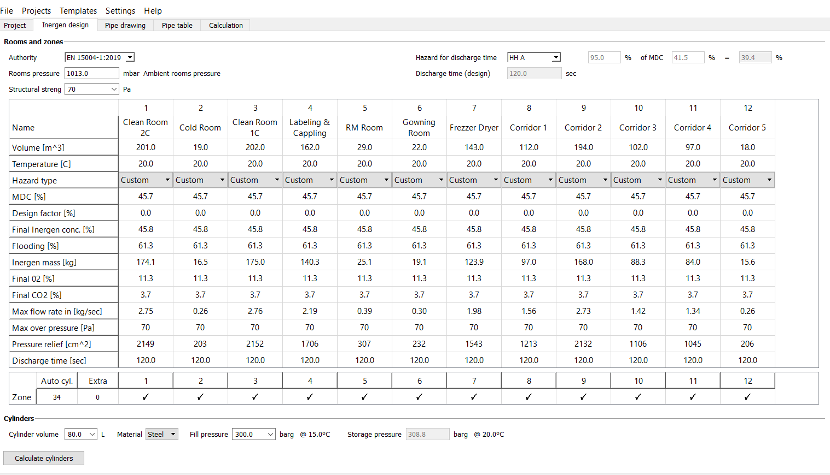

IMT – Inergen Management Tool
Sol
Software that optimizes sales and engineering:
A complete solution
Quick pricing
Fire protection of high quality
Benefits of IMT:
Efficient planning, tender and documentation
Quick price estimates
Minimizing the risk of errors
Easy access to current prices
Easy to use

Slide 9
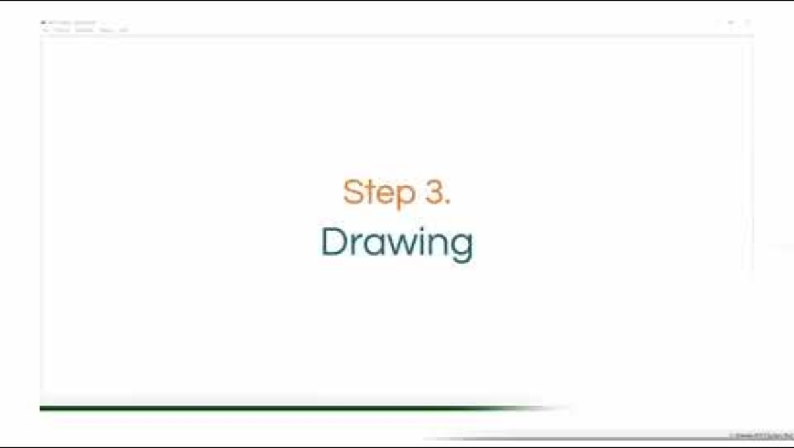

Slide 10

7 reasons to choose Fire Eater
100% FOCUS ON INERGEN FIRE PROTECTION
QUALITY
INNOVATION
SECURITY
SUSTAINABILITY
SERVICE
REPRESENTED WORLDWIDE
For more information
Click HERE

Slide 11

Questions

