Slide 1
FIRE EATER
Inergen fire extinguishing systems

Slide 2
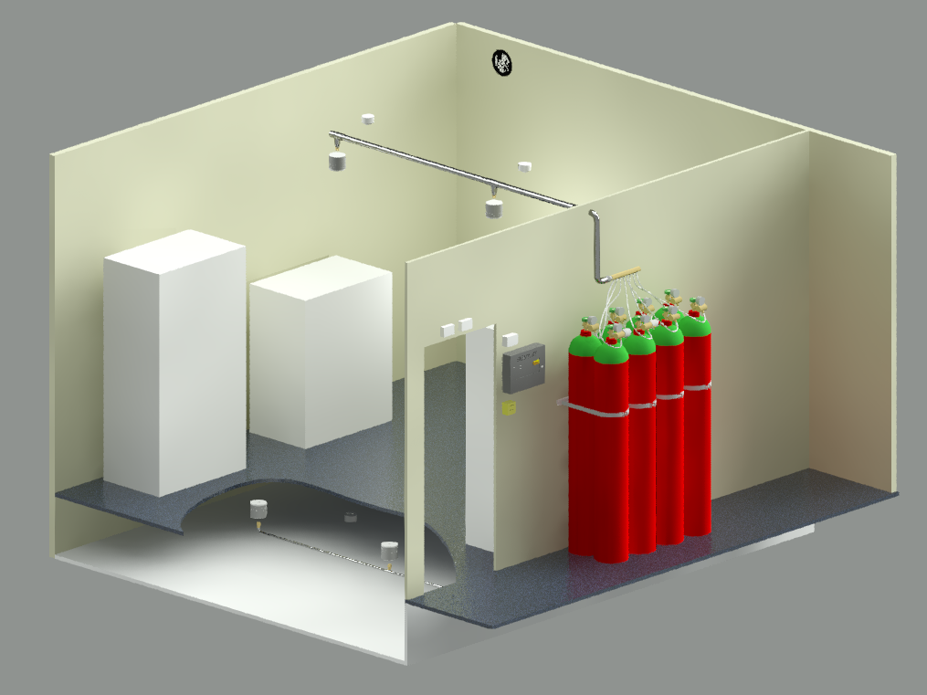
Stand Alone - a single system

Slide 3
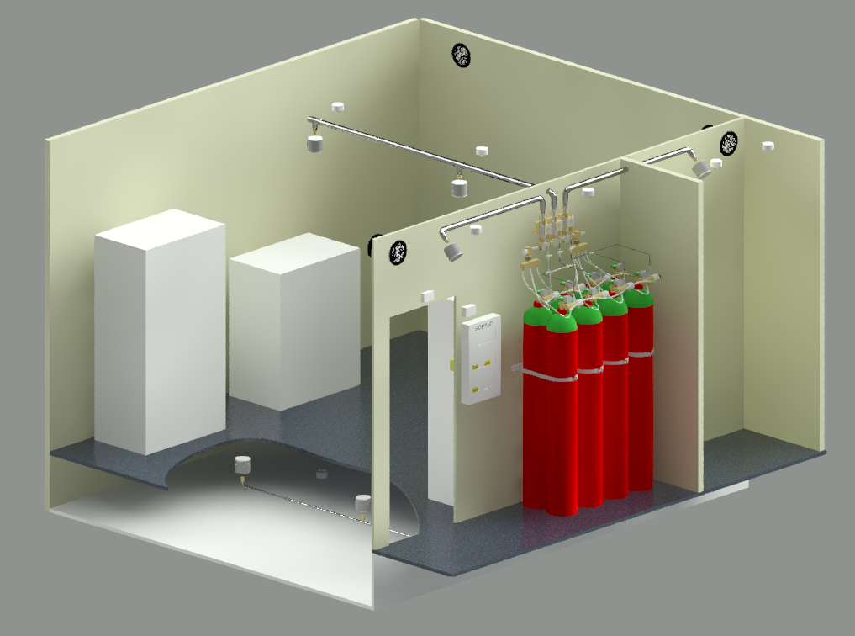
SV22 – a multi zone system

Slide 4
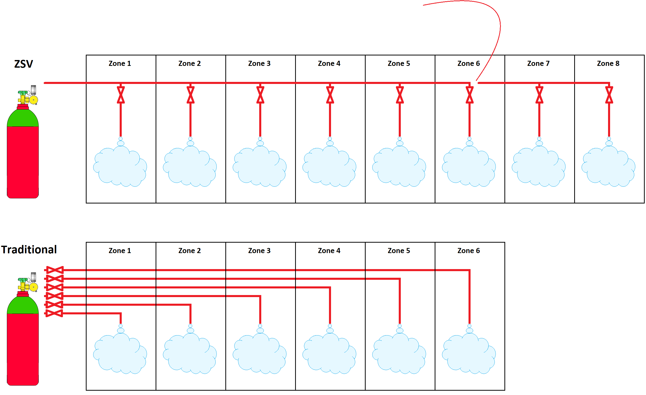

One cylinder bank -mulitiple zones
The ZSV zone valve
Less piping with our ZSV zone valve.
Easy to add on new zones later on.
Innovation

Slide 5


Approvals
Bureau Veritas – Marine & Offshore
CNBOP-PIB- Center for Scientific Research Protection, PL
FM Global - Factory Mutual Insurance Company, US
Intertek ISO 9001:2015
Intertek ISO 14001:2015
UL- Underwriters Laboratories Inc., US
ZÚS - Technical & Test Institute for Construction Prague, CZ
DBI- Dansk Brand- og Sikringsteknisk Institut, DK
MARITIME NEW ZEALAND
ABS - American Bureau of Shipping
LPCB - Loss Prevention Certification Board, UK
CCC – Chinese
DNV-GL – QS certificate of assessment – EC (module D)
DNV-GL – EC type examination certificate (module B)
PESO - Indian
VdS - German

Slide 6
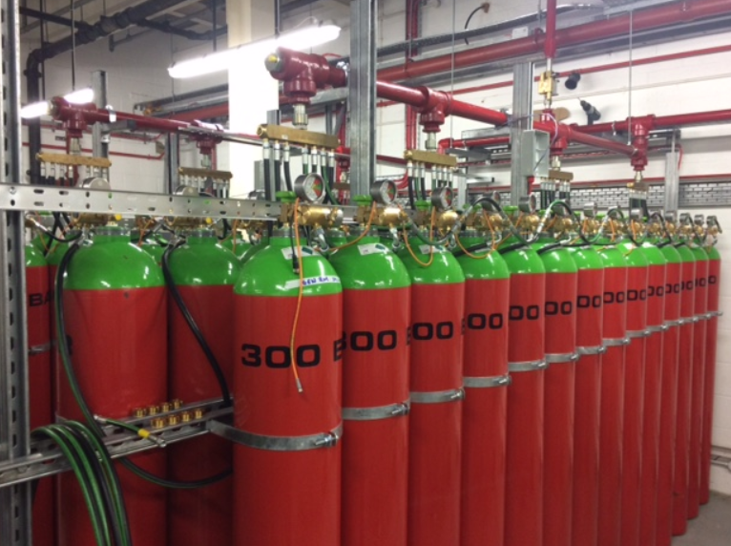
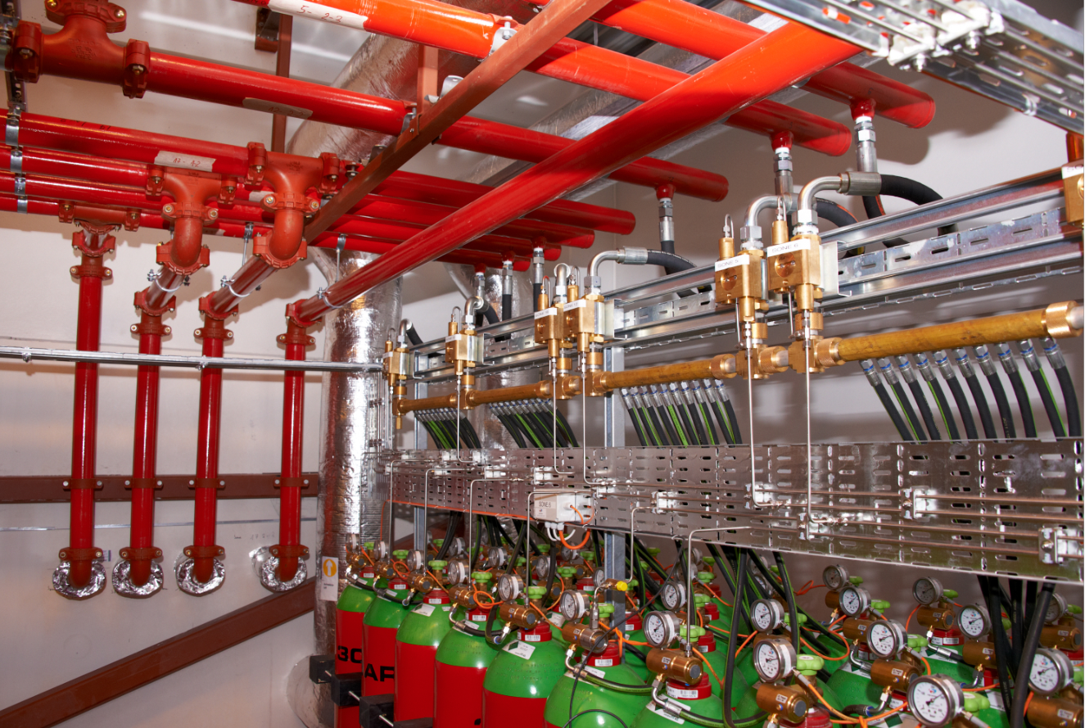
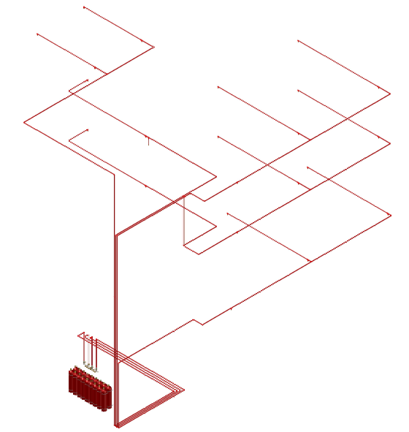
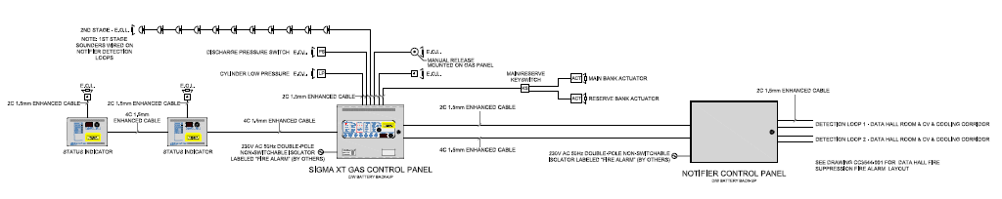
Fire Eater Engineered Design

Slide 7


Design Philosophy & Project Approach
Over 50 years experience - Fire Eater (Manufacturer)
Full integration and co-operation with partner & client
Flexible design approach
Designed to EN,NFPA and local codes where applicable
Dedicated Fire Eater IMT software for calculating design (No 3rd Party)
Only software on Market to allow for High Pressure Main Pipework calculations
Reduction in High Pressure Main Pipe using IMT.
Reduction in expensive valves and wiring – no “dead legs” on HPM.
3D or 2D AutoCAD designs.

Slide 8
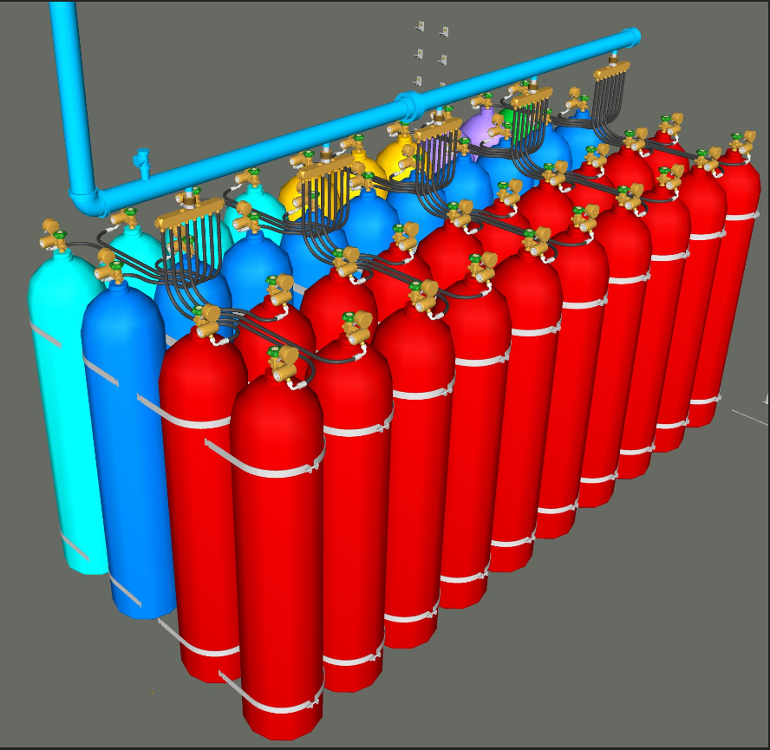
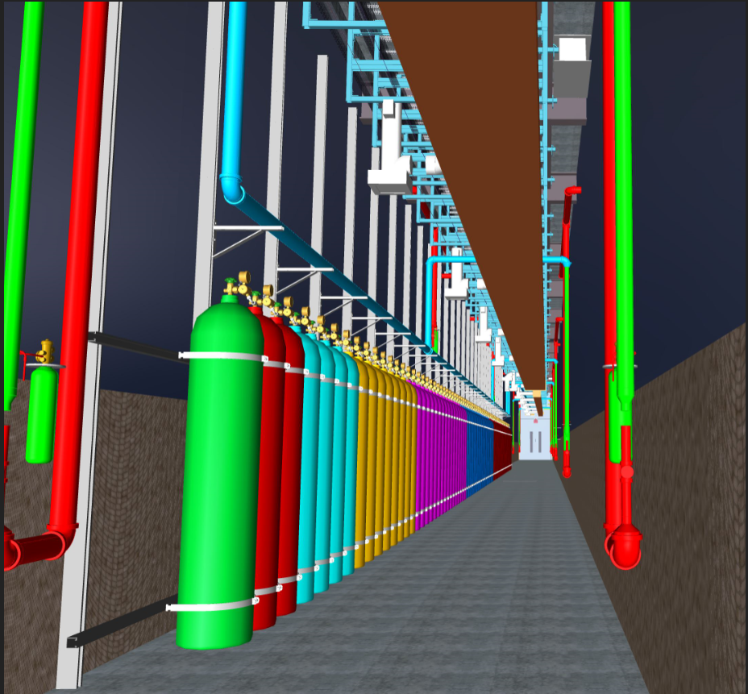
Example of 3D modelling

Slide 9
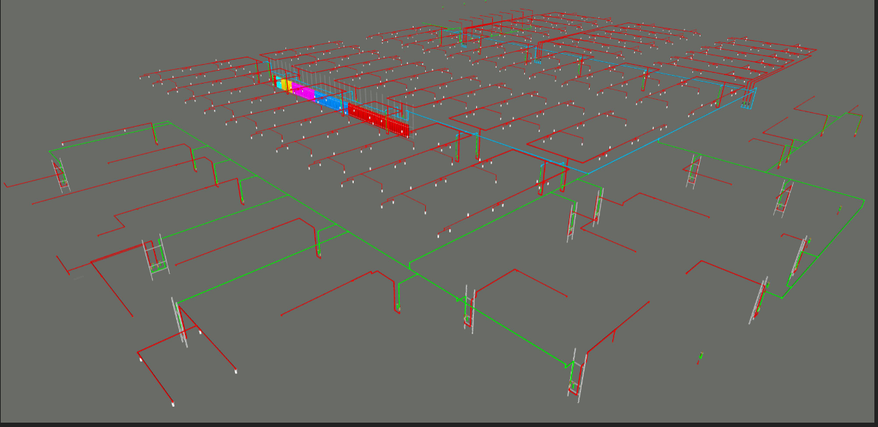
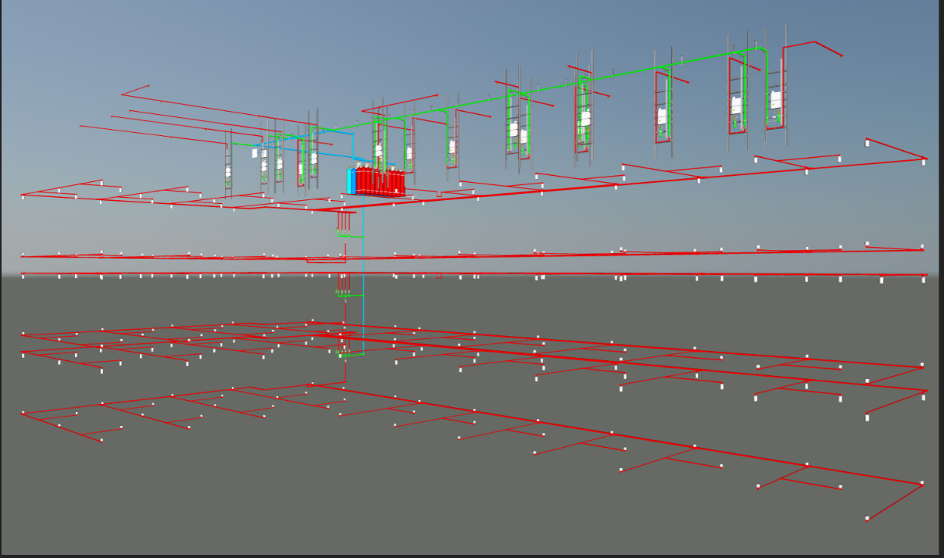
Example of 3D Modelling Cont’d

Slide 10
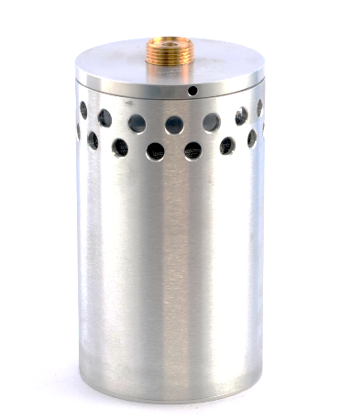
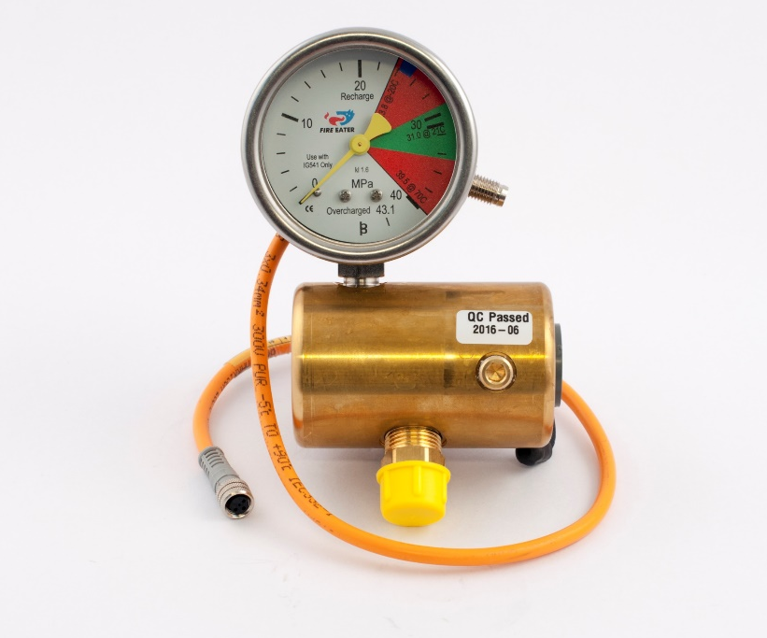
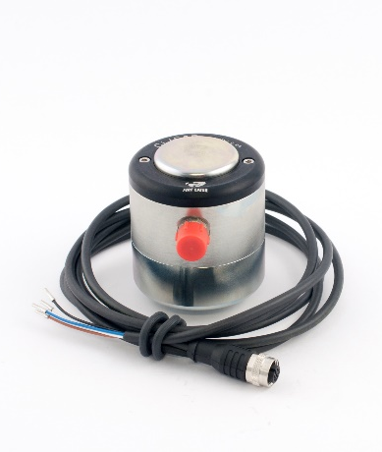

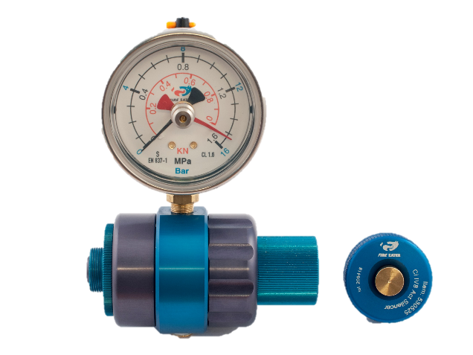
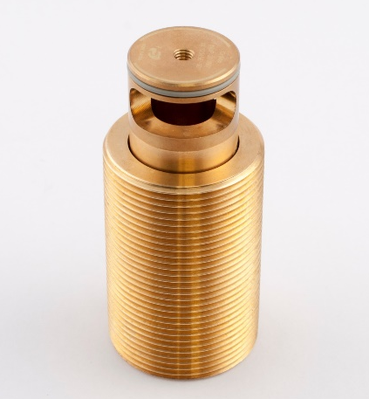
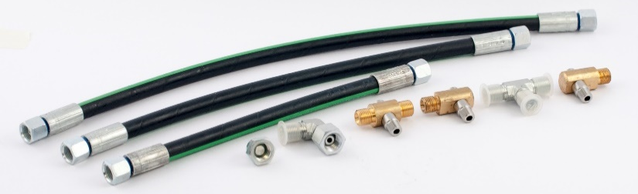
Products

Slide 11
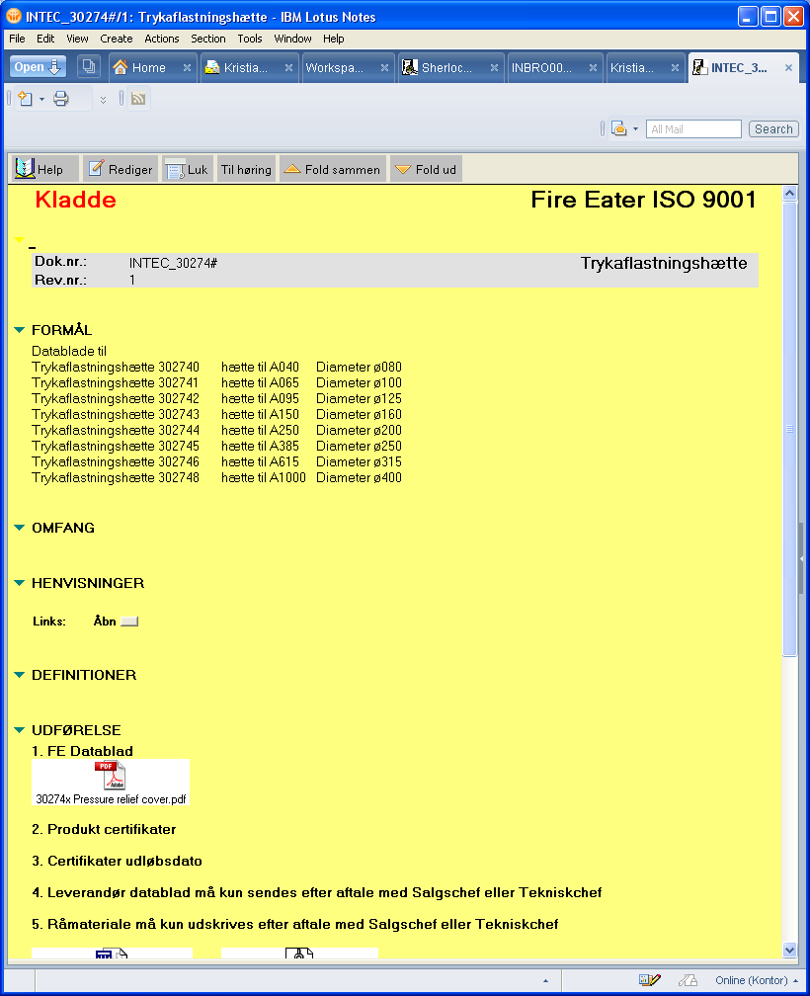
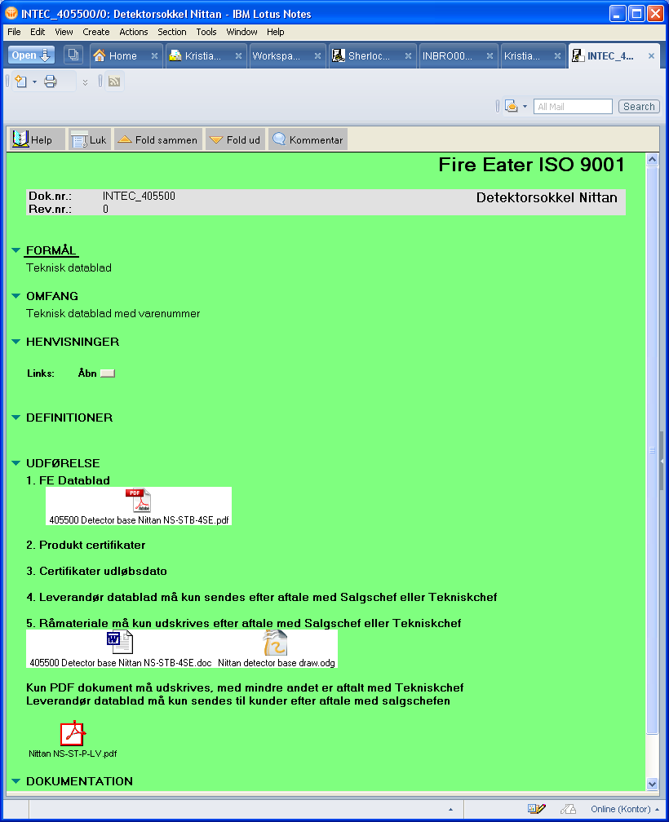
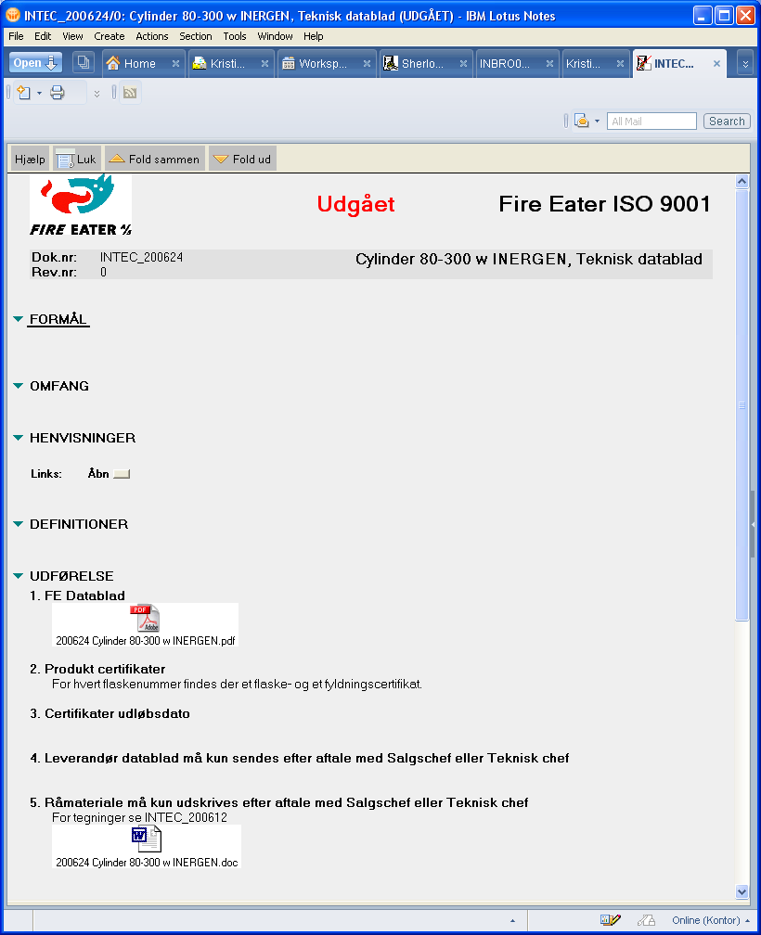
Electronic quality program
ISO9001;2008 - Fire Eater obliged to record and improve the quality assurance program.

Slide 12
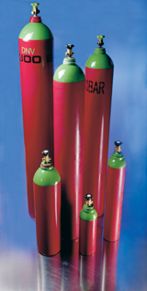
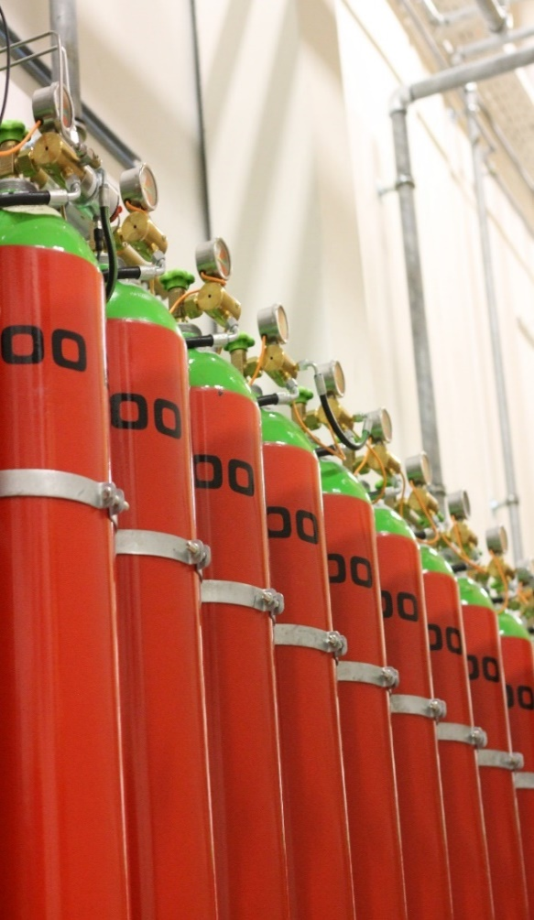
Cylinders
200 and 300 bar
140 L
80 L
50 L
30 L
200 bar only
20 L
10 L
5 L
2 L
Approval’s
TPED (2010/35/EU), π marked
UL
FM
DNV
BV
LPCB
Presure: Filling @ 15C 20 & 30 Mpa (ADR)
Colours: RAL 3000 Red – RAL Bright Green (EN1089)
Construction: ISO 9809-2 (EN1964-2)
Approval: TPED (2010/35/EU), π marked
Other: UL, FM, DNV, UN.
200 and 300 bar
140 L
80 L
50 L
30 L
200 bar only
20 L
10 L
5 L
2 L

Slide 13

Cylinders
The main components of the system are:
Cylinders: 2 – 140 liter, 200 & 300
Hand Wheel Valve: W24.32 – M25x1.5 200 & 300
Discharge valve: Ci IV8
Manoswitch: Ci Manosw
Activation system: Ci IS8, Ci IM8, Ci PA8 (Ci IW8)
Hoses: Dn10-400 500 – 4000mm - Dn6-400
Manifold system: Ci MTx (1-10), Orifice
Pipe system: Galvanized 7.6 MPa
Nozzles: Mono-orifice (land/UL/CE/FM) MED (multi-orifice, Marine)

Slide 14
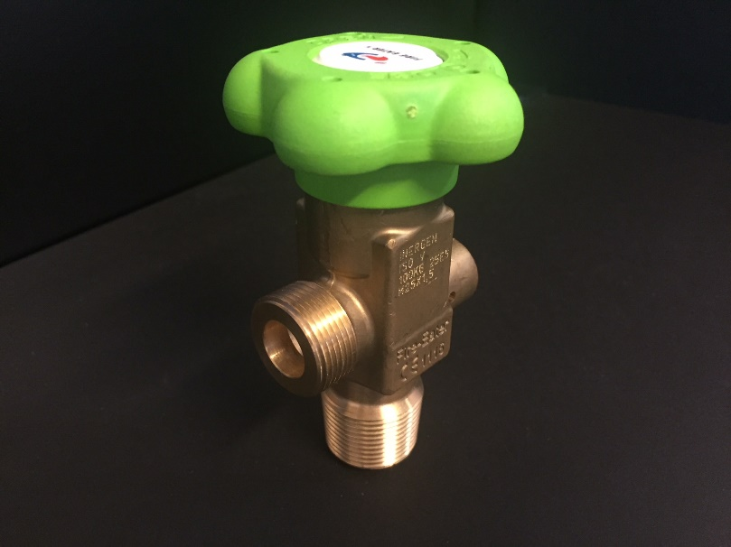
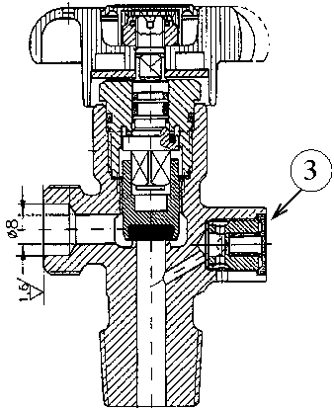
Hand Wheel Valves
Impact tested
Risk of valve breaking significantly reduced.
Limited orifice
In case of accident the effect is limited.
Integrated burst disc
Cylinder over-pressure will be safely vented.
Cylinder hand wheel valve
Risk of spontaneous discharge during handling eliminated.
Double approval - TPED, π marked & CE mark

Slide 15
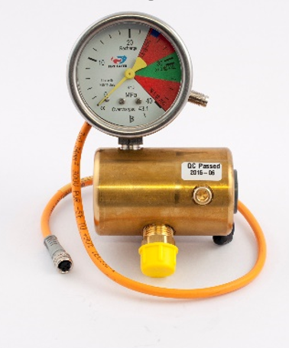
Activation (pneumatic and back pressure)
Triggering pres.: 10 – 400 bar.
Min.: 8 bar 2 sec (0.01 l/sec).
Max. no triggering: 2 bar 10 sec.
Temperature: -50 to +70°C.
Approval: UL and FM use -60 or -62.
Pressure
Work: 300-400 bar.
Proof (burst): > 1440 bar.
Burst disc: 480 ± 20 bar.

Slide 16
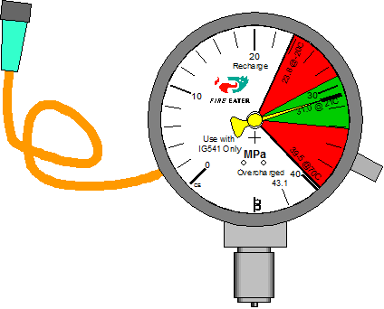
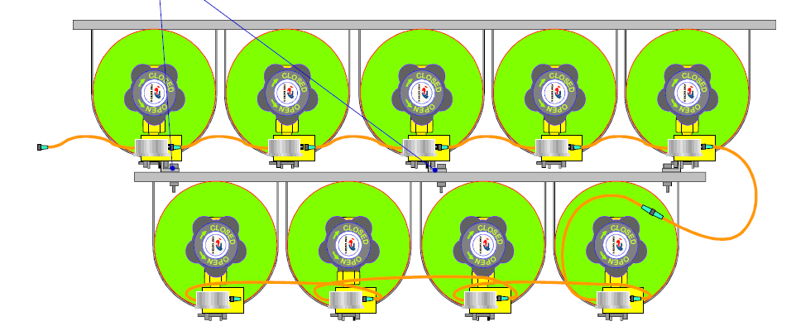
Manoswitch
CI Manoswitch
EN12094-10 (CPD) Approved
Features dual End Of Line resistor (fully monitored circuit)

Slide 17

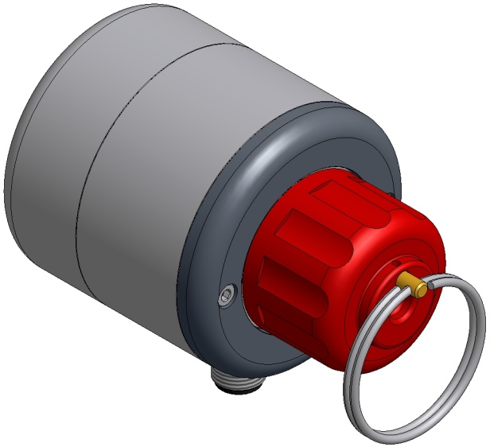
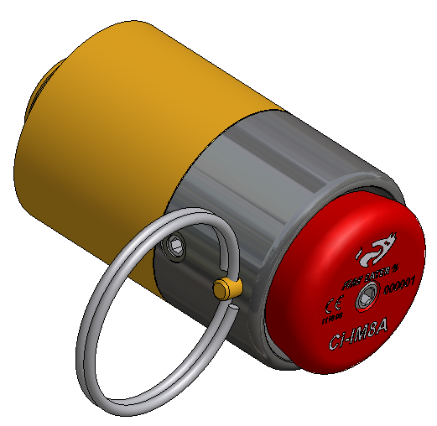
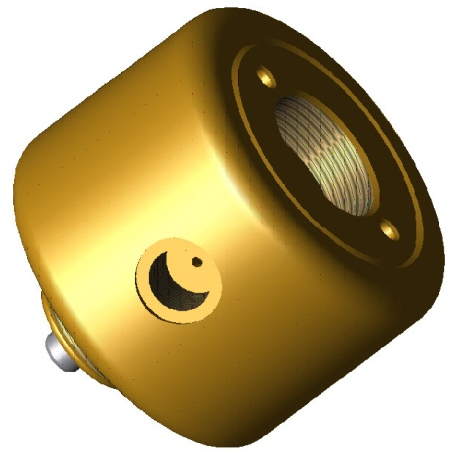
Activation System
Ci IS8B Electric actuator
Ci IM8 Manual actuator
Ci PA8 Pneumatic actuator
(Ci IW8 Wire Rope)

Slide 18
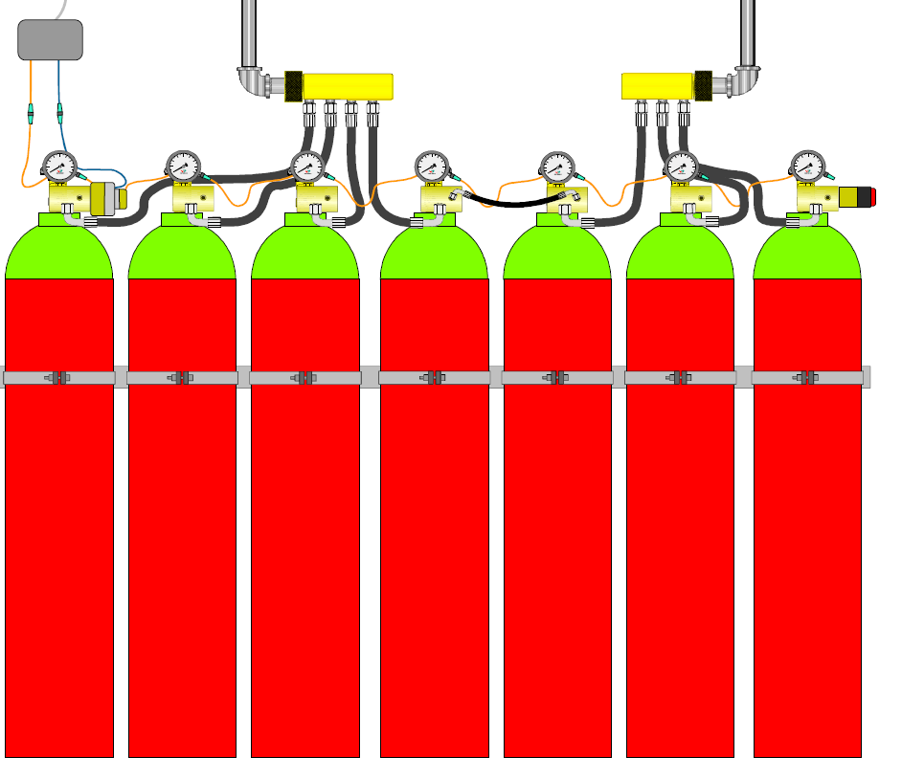
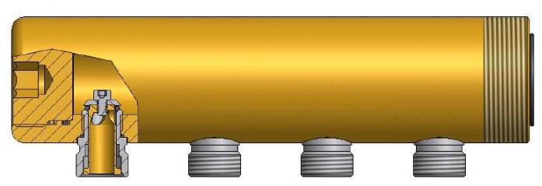
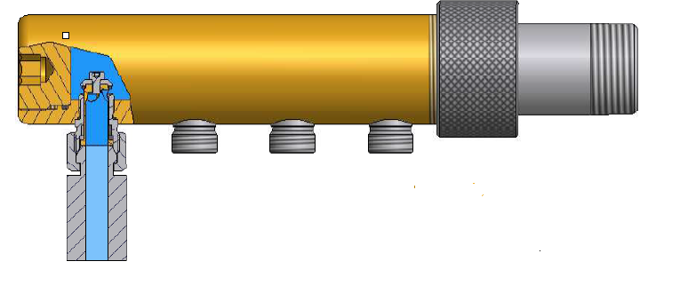
Back Pressure Activation

Slide 19
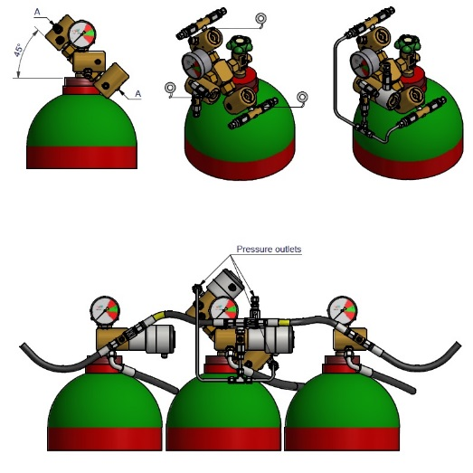
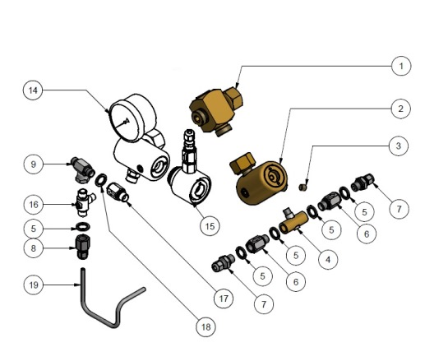
SV-CiV DVx
305294 SV-CiV DV-2 M25 (300 bar)
305295 SV-CiV DV-3 M25 (300 bar)
305296 SV-CiV DV-2 W24 (200 bar)
305297 SV-CiV DV-3 W24 (200 bar)

Slide 20
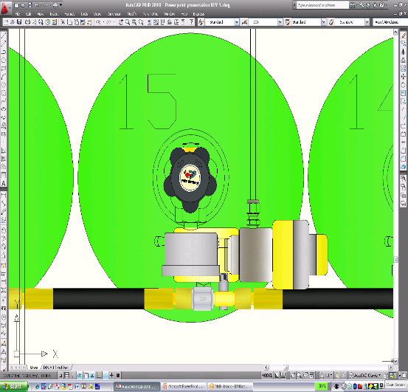
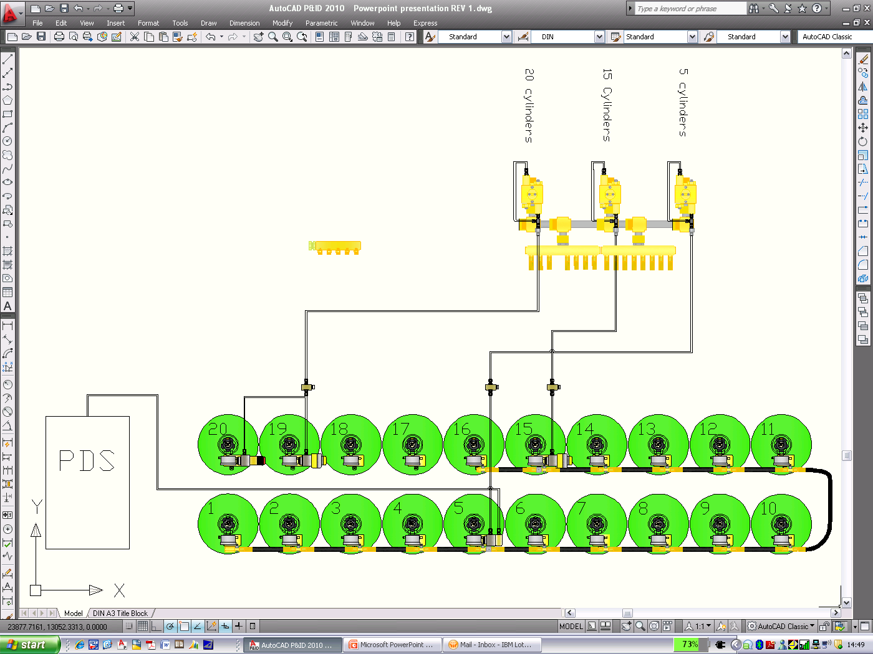
SV22 Zone kit
305170 SV22 Zone kit ISO
305171 SV22 Zone kit NPT

Slide 21
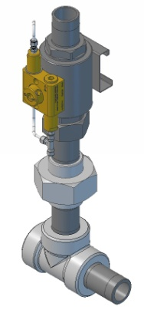
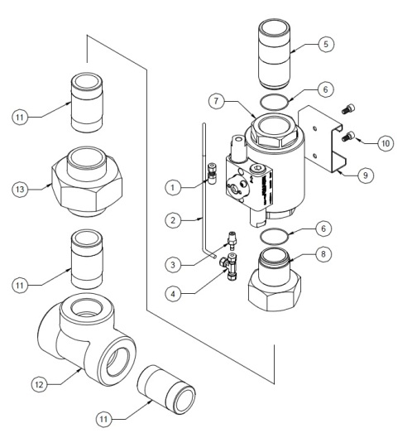
SV48 Zone kit NPT
Pos. Item Description Material
1 301328 Comprs fit ø6-1/4 Strht SS
2 102012 Tube Ø6 SS
3 214301 Comprs fit Ø6-1/4 bspt stud SS
4 210035 Comprs fit Ø6 Tee SS
5 304306 SM48 Pipe adapter NPT Steel+Zn
6 2505180 O-ring 50.52x1.78 EPDM
7 304450 SV48 Selector Valve
8 304420 Orifice NPT Steel+Brass
9 305120 Mounting Bracket Steel+Zn
10 3340105 Screw M8x10 Inhex SS
11 304460 Pipe Nipple 100mm Steel+Zn
12 304466 ASTM Tee NPT 2” Steel+Zn
13 304468 ASTM Union NPT 2” Steel+Zn

Slide 22
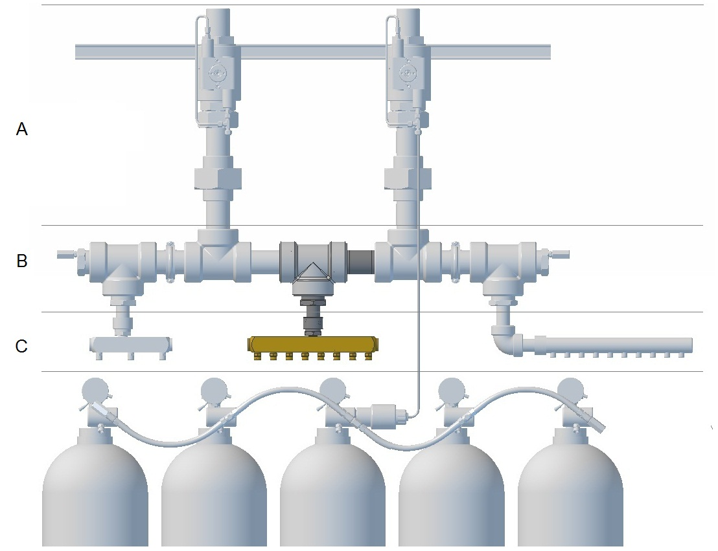
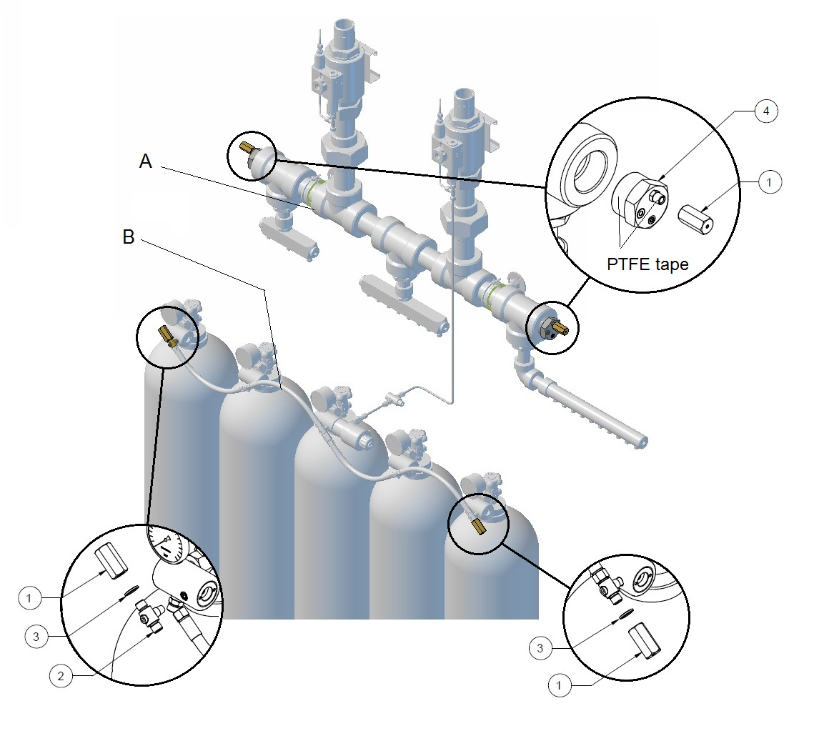
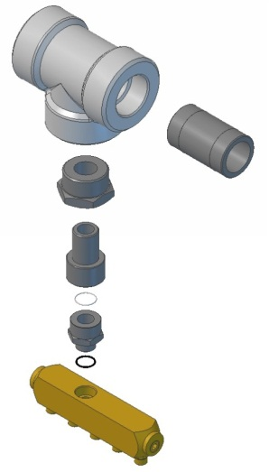
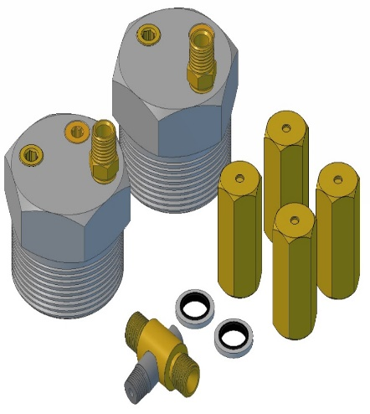
SV48 Manifold kits

Slide 23
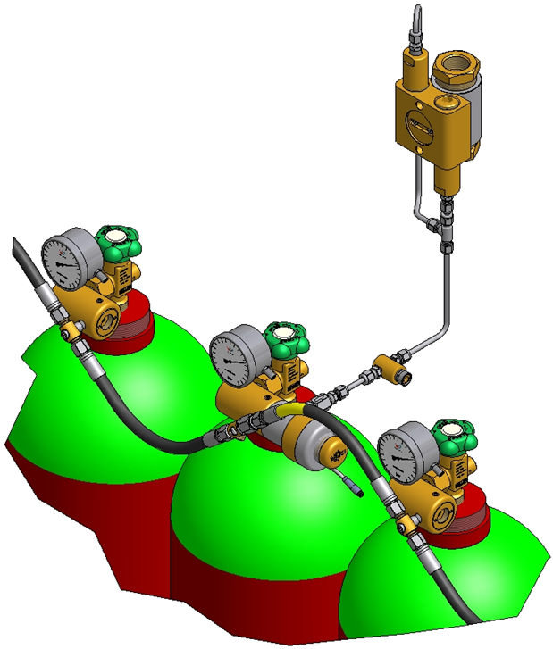
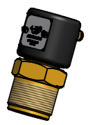
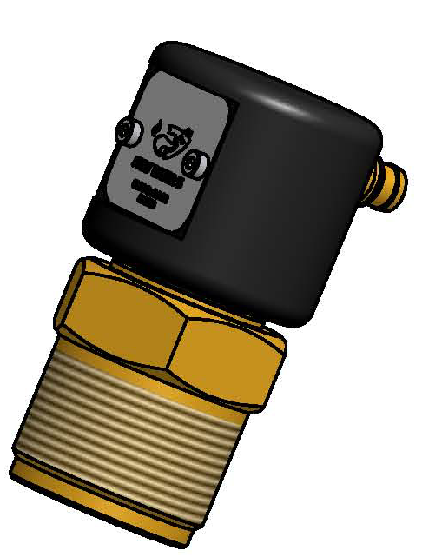
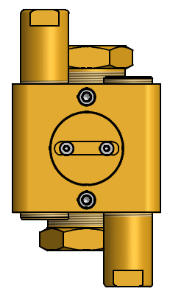
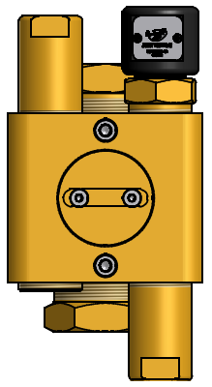
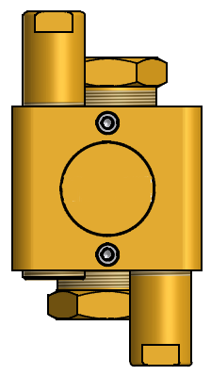
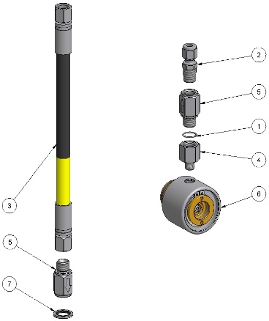
SV Components
305186 SV Switch fully open
SV22 Valves – 100 % Live testing

Slide 24



305183 SV Test Port Kit

Slide 25

Nozzles
Mono-Orifice Nozzle:
Included in UL listing and FM approval
Max coverage area 7.32 x 7.32m - Pressure 2 -12.5 MPa - 360 deg - Dn 15 - 32 - Orifice: ø1.0 – ø3.0 (with filter) ø3.0 – ø31.9
Material: Brass
Thread: ISO (BSPT, Krg) npt

Slide 26

Nozzle Silencer
Silencer:
Included in UL listing & LPCB Approved
Reduces noise by approx. 20 dB up to Dn 25
Material: Aluminum

Slide 27

Maintaining Integrity
of HDD in a Noisy Environment
Automatic clean agent fire extinguishing systems have been definitively shown to adversely affect HDD I/O performance during discharge due to noise.
Typical discharge level of peak flow system – 120dB to 140dB & constant flow system – 5dB.
Studies conducted by Siemens, Tyco & Fire Eater since 2010 found that hard disks are not damaged at noise below 110dB.
The critical range of frequency was found to be between 1.6khz and 8khz1.

Slide 28
3 reasons to choose FSN Nozzles
3rd Party Approvals
Proven Technology
Engineered by experts

Slide 29


Solution FSN Nozzle Silence
More Nozzles
Flow Rate
Increased Dischange time

Slide 30


FSN Nozzle
~ 92dB Output
Optimum Flow Rate 1.27Kg/Sec
50m3 Nozzle Coverage

Slide 31



We provide the right tools…

Slide 32
Summary…
Worldwide network, 3rd Party approved product, Long standing engineering company, fully certified design, proven product

Slide 33

Questions

