Slide 1
FIRE EATER A/S
The inventor of Inergen
fire extinguishing systems

Slide 2
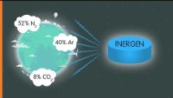

Slide 3






Benefits of Inergen
No damage to equipment
Safe for people
Sustainable solution - harmless to the environment
No loss of revenue
The world's safest solution

Slide 4

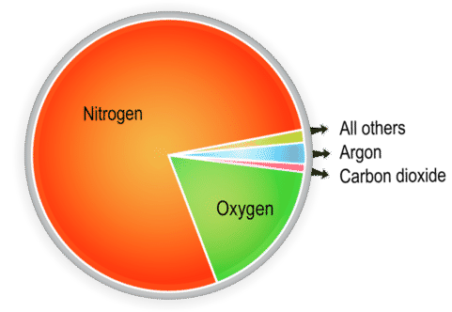
What is Inergen?
Ordinary atmospheric air
Inergen is a mixture of natural gases which has no harmful effect on the environment or humans.
Inergen
52 % Nitrogen
40 % Argon
8 % CO2
Ordinary atmospheric air
78.1 % Nitrogen
20,9 % Oxygen
0,9 % Argon
0,037 % CO2

Slide 5

Your safety – is our business

Slide 6
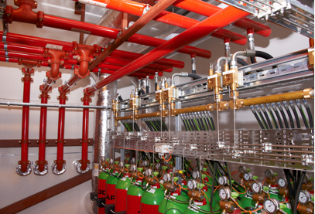
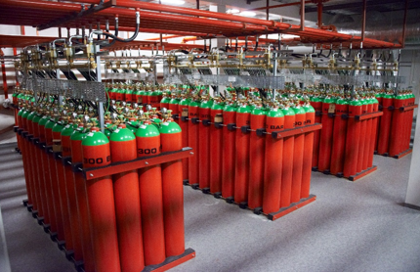
Why Inergen®

Slide 7
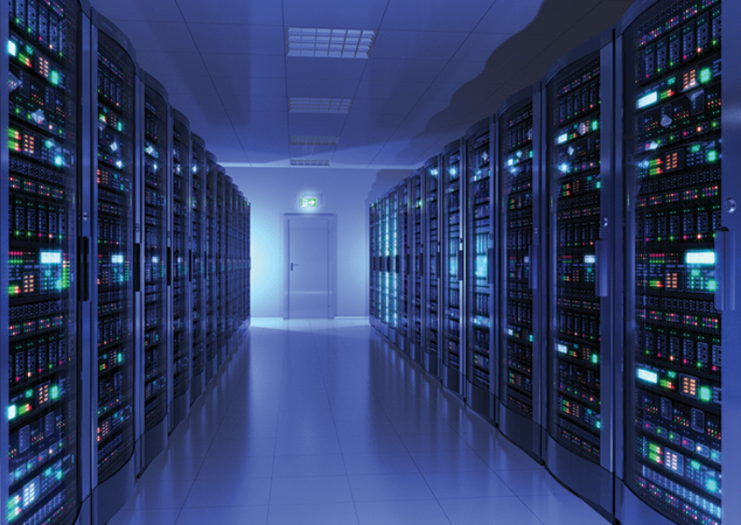
Why Inergen®
Name comes from Inert gas +Nitrogen = Inergen
52 % Nitrogen, 40 % Argon, 8% CO2.
Zero ozone depletion (ODP).
Zero global warming potential (GWP).
Non-toxic & fully tested on humans.
Discharge testing possible, more than 5000 live full- scale tests completed to date.
Approved for occupied spaces.

Slide 8
5 reasons to choose Inergen
High fire extinguish-ment capability
Does not produce any toxic by products of thermal decomposition
Similar density to air – good retention times
Provides a lasting 3-dimensional extinguishing effect.
No fogging, clean, no residue, dry & non-conductive

Slide 9


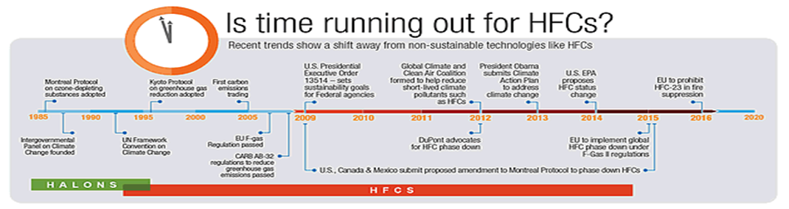
Market Trends for Gaseous Agent
HFC’s are being phased out in Europe since 2016 with full phase out by 2030.
FK5-1-12 currently under review as a PFAS gas (Poly-Fluorinated Alkyl Substances).
Move away from chemical agents in Scandinavia and Switzerland.
EPA in USA have moved forward and commenced HFC Phase Down.

Slide 10
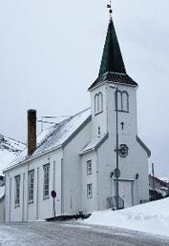
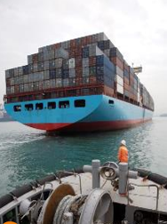
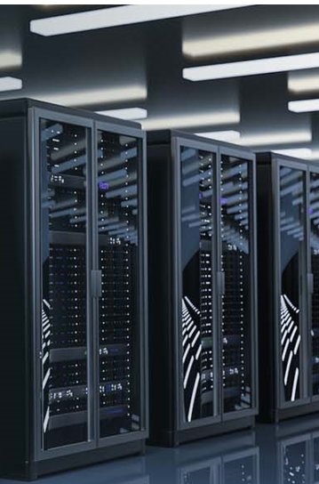


Inergen can be used in all types of industries
Examples of Industries:
Data Centre
Buildings worthy of preservation
Museums
Psychiatry
Offshore
Marine
Pharma
Examples of areas of application:
Server rooms
Archives
Production
Dangerous goods
Cold storage
Warehouse robots
Warehouses

Slide 11
Summary…
Worldwide network, 3rd Party approved product, Long standing engineering company, fully certified design, proven product, futureproof and sustainable.

Slide 12

Questions

